Slide 1
Analyst result briefing
Interim financial period ended
31 march 2016
26 May 2016

Slide 2
highlights
Net profit after tax (NPAT) improved $9.2m (96%) to $18.8m
Improved foreign exchange environment relative to last year positively impacted half-year performance
Improved salmon business performance driven predominantly by a higher value product cascade and focus on fresh
Positive performance evidenced in the wild catch business delivered from lower catch volumes, with a more targeted product mix, at better prices
Improved returns due to the 2015 exit from the International Pacific tuna business, despite impairment of the remaining vessel at balance date, the San Nikunau
Reduction in overall supply chain costs

Slide 3
Improved GROUP ADJUSTED EBIT* by 7.3%
Reported EBIT growth of 25% impacted by a $5M impairment of the remaining IPS vessel, holding costs for this vessel and a provision reversal.
*Total business including discontinued operations

Slide 4
ENCOURAGING Profit Growth for group

Slide 5
FX continued to move in our favour

Slide 6
Recent press
A report recently released which is unfortunately being the subject of much media hyperbole is not based on appropriate evidence to draw the conclusions which are now being touted in the media. Sanford wish to reiterate that we:
Focus on landing all QMS species and pay for these
Find dumping of fish abhorrent and entirely against the values by which Sanford operates.
Don’t waste fish – any fish that is landed and can’t be eaten is put into fishmeal.
Expect 100% compliance of all our fishers including all those who lease our ACE.
Take action if there is behaviour on the water that is against the law or our brand values so we can stop it from happening.
Operating responsibly and in adherence with regulations is a non-negotiable element of our business. Without due care for our resources we risk the future of our business.

Slide 7
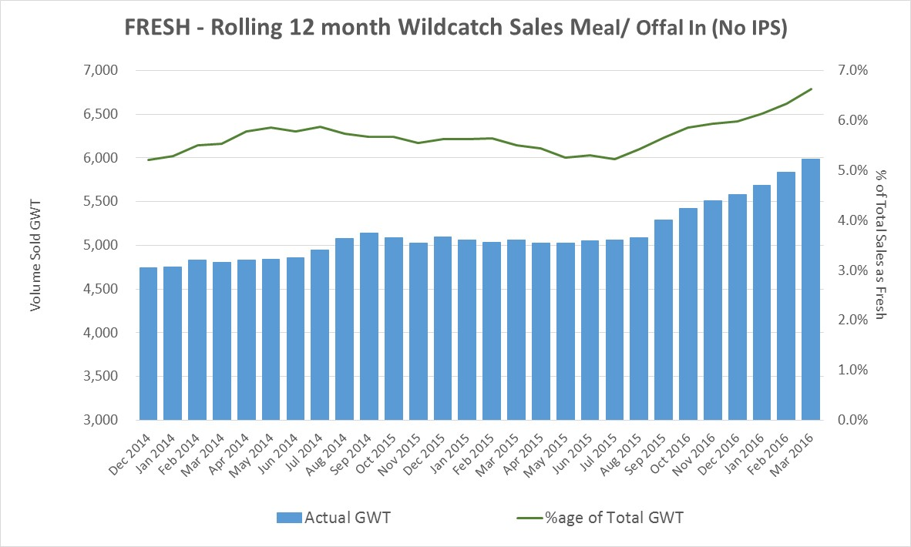
Focus on customers
Appointment of Andre Gargiulo as Chief Customer Officer will enhance the focus on maintaining and building the strong relations with our existing customer base and the development of new business relationships across the globe.
‘Focus on Fresh’ emphasises an increasing allocation of raw material to the chilled sector.
Move towards in-market specialists to establish closer links with our customers, constantly challenging ourselves to exceed customer expectations of delivering pristine quality New Zealand sourced products.

Slide 8
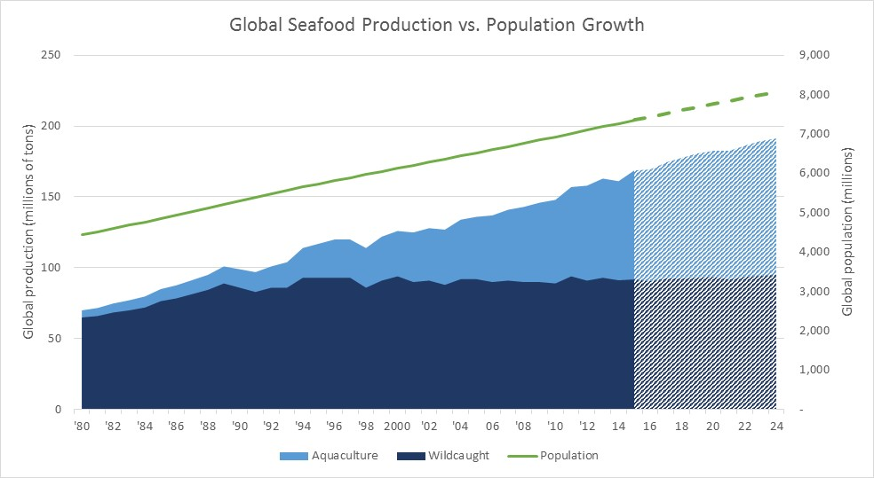
Global seafood production growth to come from aquaculture
Growth from Aquaculture expected c.15 million tonnes
By 2024 Aquaculture is forecast to be equal to wildcatch in global production
NZ wildcatch accounts for 0.3% of global wildcatch, and aquaculture accounts for 0.1% of global production
Global population will continue to grow and consumption of seafood expected to increase
Source: United Nations and OECD

Slide 9
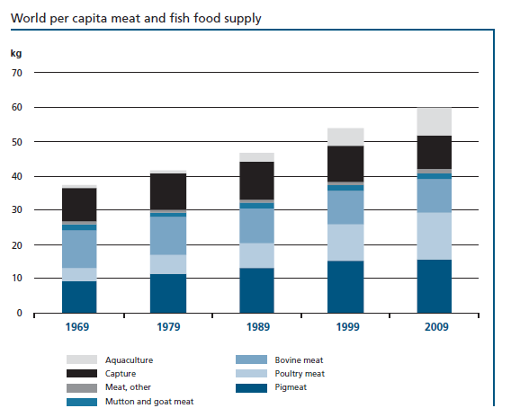
Increasing consumption per Capita
Aquaculture consumption per capita has grown steadily since 1969, while Bovine meat declined
Source: United Nations and OECD

Slide 10
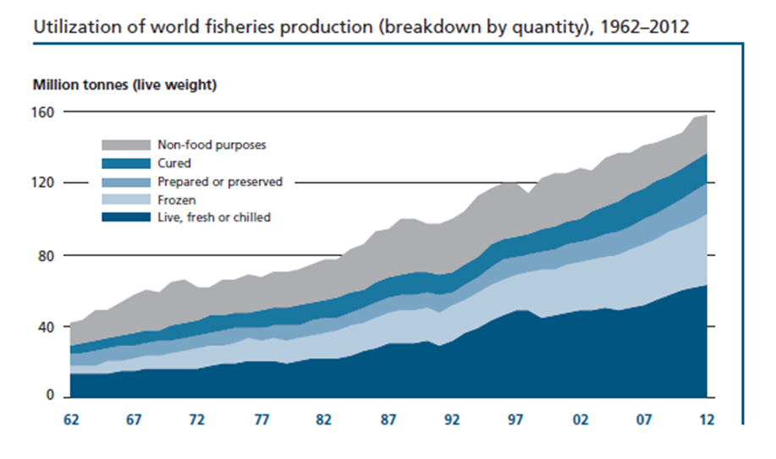
Increasing consumption
Live and Fresh Seafood trend is good
Source: United Nations and OECD

Slide 11
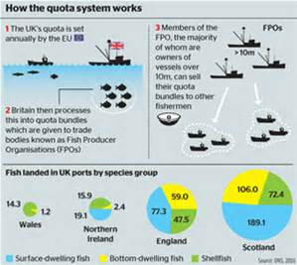
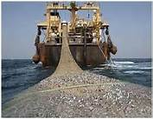
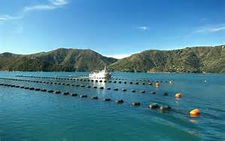
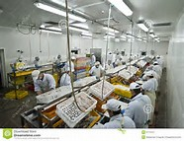
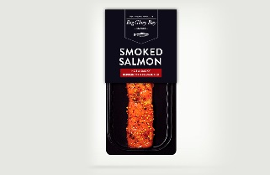
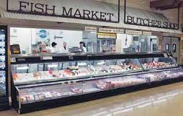
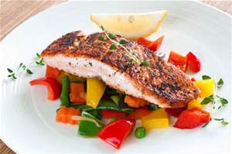

How will we win in a competitive environment?
Others in the Global Seafood Value Chain
Value
Value through Efficiency
Value via Brands
Opportunity

Slide 12
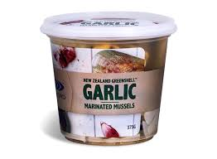
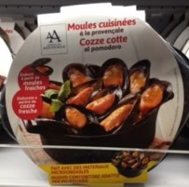

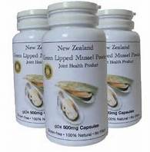

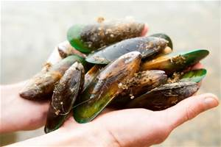
How do we build value?
$5.80
$180
Foundation
Value Creation

Slide 13
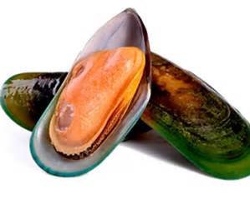
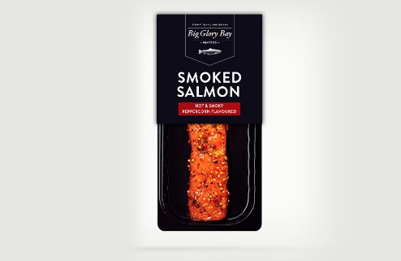
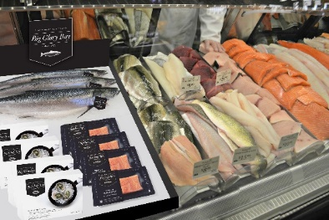
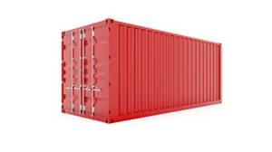
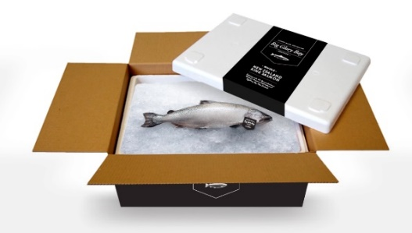
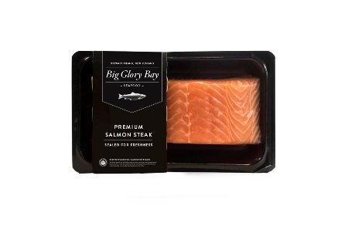
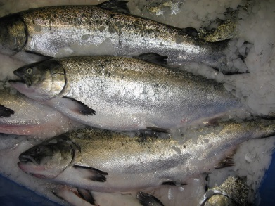
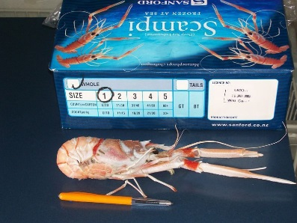
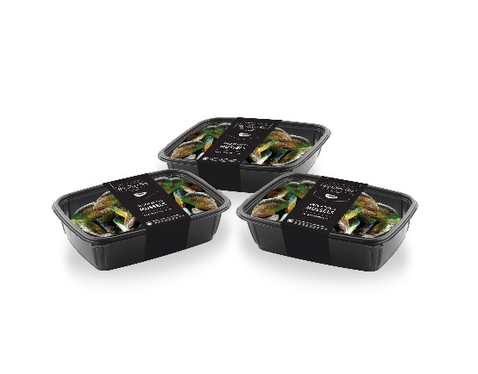
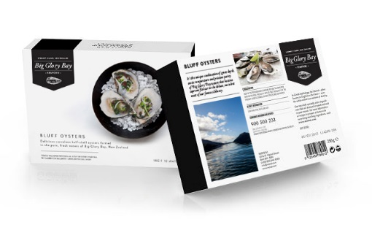
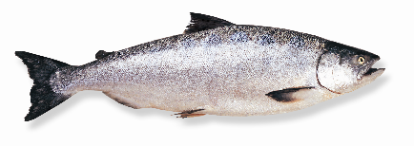
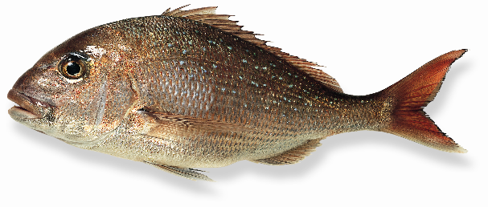
Transition from global commodity to provenance value

Slide 14
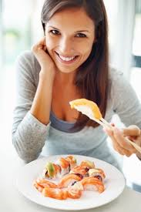
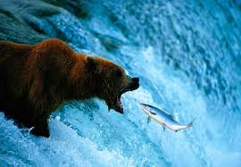
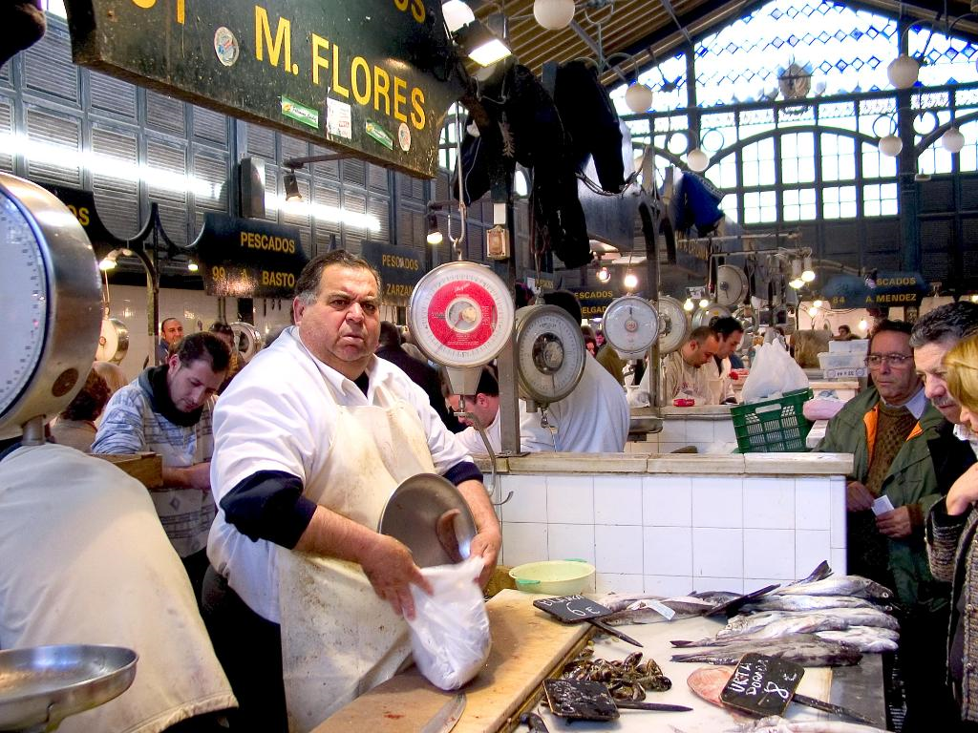
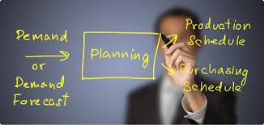

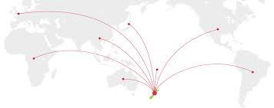
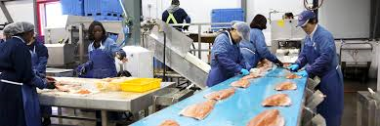
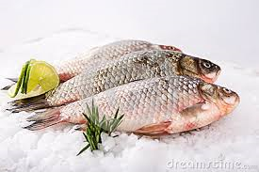
Our decisions will start and finish with our customers and consumers.

Slide 15
Focus on fresh fish from new Zealand
Increasing demand from
  New Zealand
  Australia
  Asia
  Rest of the World
NZ offers great variety
Precision Seafood Harvesting as a game changer
Simplified processes, streamlined logistics
Establishing the link to consumers
Provenance
Gateway to Asia
15

